Slide 1

Major Project –IA -1 Master of Science in Computer Science IV Semester – 2022
School of Computer Science and Applications

Slide 2
A PROJECT REPORT ON Air Pollution Forecasting using LSTM and GRU
Submitted IA-1 Project report completion of MSc degree
Presented by:
Mr. Davada Juned Aslam
SRN: R20SCS06
Internal Guide : Dr. Hemanth K S , Associate Professor.
External Guide : Prof. Adithya
<number>

Slide 3
Agenda
Introduction
Abstract
Software hardware Requirement
Existing system and Proposed system
Methodology used
Dataset
Conclusion
2

Slide 4
Introduction
With the development of industry In last few years , we have to comprise with the air quality quite a lot. Even though we are not getting the air quality as good as earlier.
The Air pollution is a mixture of hazardous substance from both human and natural resources.
Vehicle emissions, fuel oils and natural gas to heat homes, by-products of manufacturing and power generation, particularly coal-fueled power plants, and fumes from chemical production are the primary sources of human-made air pollution.
Because of this polluted air quality many people are getting infected and getting a harmful disease like lung cancer and many more.
To control this air pollution we have to take care of many things like what will be the dew on that day , what will be the temperature on that day , what will be the air pressure and many more like that.
The Dew point is the temperature the air needs to be cooled to in order to achieve the relative Humidity.
Due to the air pollution even global warming is affecting.
3

Slide 5
Cont..
The air pollution could not just affect the human being it can affect the plant ecosystem also and it can even destroy the plant.
The air pollution depends upon the different parameters like the if the snow is there on that day then the Pollution will remain low on that day. And if there is no rain or no snow on that day then the pollution will be high on that day.
Other parameters like if the wind speed is more that the pollution on that area will remain low.
The pollution will be high if there is no rain , no snow and even there is very low wind speed in that area and the temperature is high.
The pollution can very from hour to hour so we have collected the every hour of data with all the parameters.
We are going to develop the model which can forecast the Air pollution based on the previous data using RNN(Recurrent Neural Network) algorithms which are LSTM(Long-short term memory) and GRU(Gated Recurrent Unit).
4

Slide 6
Abstract
With the growing of industry we are facing the issue related to the air pollution on the daily basis. The air pollution can produce with the vehicle the chemical factory and many more.
To address this problem of air pollution we are approaching the Deep Learning to overcome this with the help of RNN (Recurrent Neural Network) algorithm which are LSTM(Long-short term memory) and GRU(Gated Recurrent Unit).
We will take the input for previous 15 days of data and we are going to forecast the next 24 hours of pollution.
5
5

Slide 7
Software and hardware requirement
Operating System : Windows 10
Software requirement : Python3 , sklearn , tensorflow , pandas , numpy
Hardware requirement : 8gb ram , 120gb storage
6

Slide 8
Existing system and proposed system
In real time there are the website and some weather app , which are showing the real time Air pollution index on the basis of sensor the data which they have collected.
In real time there are no any website which can forecast the air pollution they are just giving us the data which they have collected using the different sensors over there in atmosphere.
But for our model we don’t need any real time data instead of that we can just use the existing data which they have collected and we can forecast on the basis of that.
The proposed project is that we just have to give the last 15 days of data and based on that it will forecast the Air pollution based on that. We have to give the data based on this parameters like Dew , temperature , pressure , wind_Dir , wind_speed , snow , rain and pollution.
7

Slide 9
Methodology used
For forecasting the data we have used the RNN(Recurrent Neural Network) algorithm which are LSTM(Long short term memory) and GRU(Gated Recurrent Unit).
In this we just have to give the last 15 days of data and based on that we are forecasting the data.
We will show that data on hourly basis because we are collecting the data on the hourly basis from the sensors.
8

Slide 10
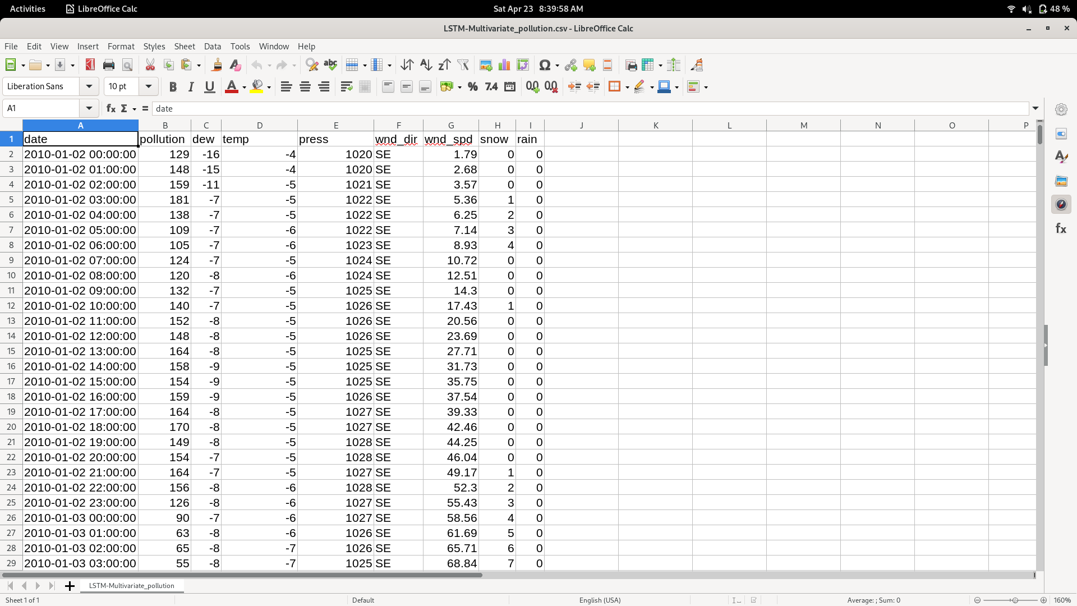
dataset
9

Slide 11
Conclusion
This model can help the people to forecast the Air pollution so they can be safe they can wear a mask and go out. And can take precautions.
The model which we have created getting the accuracy of around 80% and we are still trying to get the better result to come out of that.
Currently we are generated 2 model LSTM and GRU but in future we are going to combine both of that model to get the even more better accuracy.
9

Slide 12
Thank You

